Slide 1
Let’s learn logical instructions SESSION 7

Slide 2
Logical Move!
Operations supported:
Shift
Shift Left → Instruction → sll
Shift Right → Instruction → srl
AND (bitwise)
and / andi
OR (bitwise)
or / ori
NOT (bitwise)
nor (no nor immediate)

Slide 3
Let us learn one by one, logically! SLL and SRL:
First, let us take Shift operations.
The shift can be done to the left or right based on the instruction.
Also, the emptied bits shall be filled with 0s just following the shift tradition.
Let us meet a situation to understand the shifting!
Assume that $S2 has got following content: (32 Bits, don’t forget)
11ten = 0000 0000 0000 0000 0000 0000 0000 0000 1011two
Let us do a shift left by 4 with the above input. After shifting, the result what we get would be:
176 ten = 0000 0000 0000 0000 0000 0000 1011 0000 two
Let us also do a shift right by 4 with the above input (176 ten)
176 ten = 0000 0000 0000 0000 0000 0000 1011 0000 two after shift right by 4,
11ten = 0000 0000 0000 0000 0000 0000 0000 0000 1011two
Moral of the story – SLL is complement for SRL

Slide 4
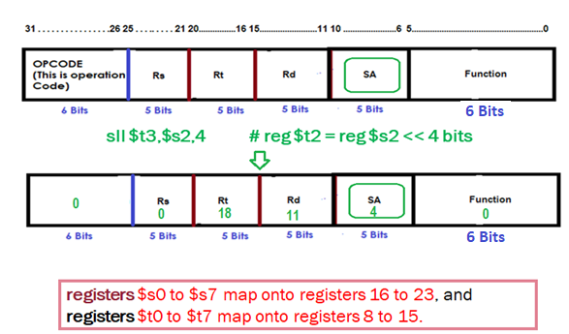
Contd.,
The instruction to perform the SLL is presented below. The result is expected to be moved to $t3. The content to be shifted is present in $s2.
sll $t3,$s2,4 # reg $t2 = reg $s2 << 4 bits
Time has come to use the SHIFT field in the R – Type Instruction. (Remember??, we marked it not applicable, earlier)

Slide 5
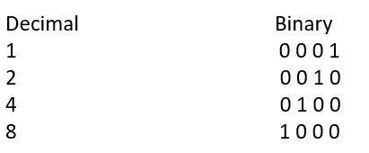
Additional Responsibility of SLL
Shifting left by n bits gives the same result as multiplying by 2^n.
How this is possible? Simple, see below.

Slide 6
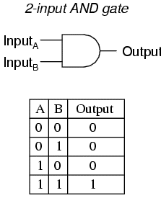
and it is AND!
AND needs both the bits to be 1. You remember AND truth table?
Let us take a situation:
Register $t2 has the following content:
0000 0000 0000 0000 0000 1111 0000 0000two
Register $t1 has the following content:
0000 0000 0000 0000 1111 1100 0000 0000two
We got to AND these two. Result to be stored in $S1
and $s1,$t1,$t2 # reg $s1 = reg $t1 & reg $t2
0000 0000 0000 0000 0000 1100 0000 0000two (Hope you understand) . . .
AND Can be used for BIT MASKING! WHAT WE DID HERE IS “MASKING” and nothing else!

Slide 7
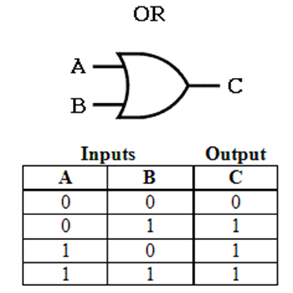
now it is OR, or we quit!
When there is AND, there is OR as well.
Again, refer the truth table. If 1 is there at A or B, result is 1.
Register $t2 has the following content:
0000 0000 0000 0000 0000 0011 0000 0000two
Register $t1 has the following content:
0000 0000 0000 0000 0011 1110 0000 0000two
We got to OR these two. Result to be stored in $S1
OR $s1,$t1,$t2 # reg $s1 = reg $t1 | reg $t2
0000 0000 0000 0000 0011 1111 0000 0000two

Slide 8
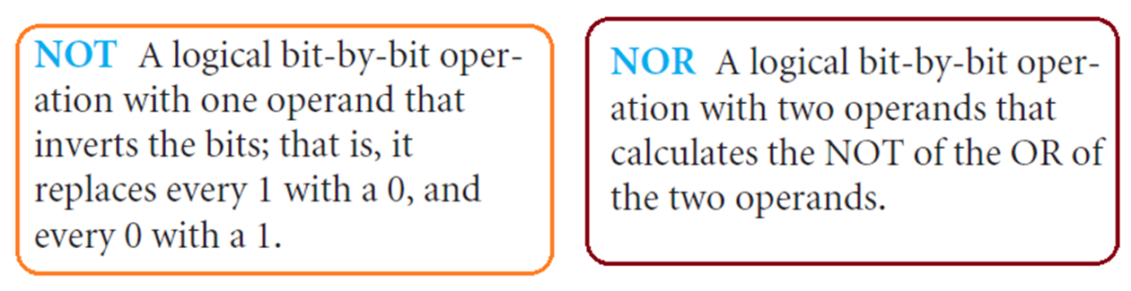
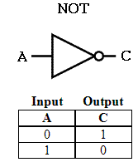

NOT through NOR!
NOT is inversion operation and as you know, ‘0’ becomes ‘1’ and ‘1’ becomes ‘0’.
Let us assume:
$t0 has the following content:
0000 0000 0000 0000 0000 1100 0000 0000two
And Register $t1
has the value “0”
Now,
The instruction is:
nor $S1, $t0, $t1 # here, it is equal to $S1 = ~ ($to | $t1)
1111 1111 1111 1111 1111 0011 1111 1111two (We got the NOT of the INPUT)

Slide 9
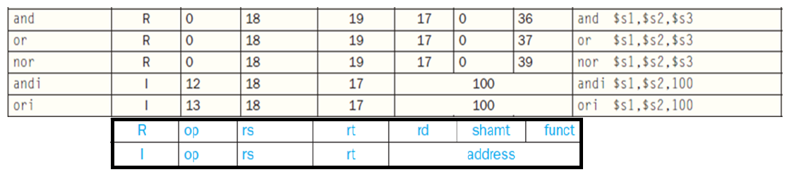
Your do it yourself.
andi
ori
A Summary!

